Slide 1
PLEDGE STORAGE RECKON (ANDROID APP)
P.NITYASREE – 17MIS1007
MTECH INTEGRATED SOFTWARE ENGINEERING

Slide 2
PROBLEM DEFINITION:
1) In fast forward world of technology, everyone is running behind the mobile application and they need all the information on the mobile phone itself.
2) This application is related to providing to Mobile Cloud Computing is internet-based computing pattern through which Shared resource is provided to devices on-demand its an emerging but promising paradigm to integrating mobile devices into cloud computing.
3) Many companies have suffered data loss from their own company due to less security. And it has to maintain the data with the security level and it has to overcome with the storage level of different types of data.

Slide 3
But with integrating into the cloud computing, security issues such as data confidentiality and user authority may arise in the mobile cloud computing system and it's concerning as the main constrains to the developments of mobile cloud computing this process personal information shared with the Unauthorized person.
Many companies have suffered data loss from their own company due to less security. And it has to maintain the data with the security level and it has to overcome with the storage level of different types of data. That will make some important data’s to be hidden for their company purpose. Because the data has to make more high credentials and most security levels for the data.

Slide 4
MOTIVATION:
Many companies have suffered data loss from their own company due to less security. And it has to maintain the data with the security level and it has to overcome with the storage level of different types of data.
That will make some important data’s to be hidden for their company purpose. Because the data has to make more high credentials and most security levels for the data by using aes encryption and habe encryption.
Dis Advantages of existing system:
User with legal access authorities to get corresponding sensing data
It is not secure personal data
Developing a False Sense of Security.
It will make requiring for all the cooperation.

Slide 5
OBJECTIVE:
In the proposed scenario, users with different privilege levels have different rights to access the part of sensing data coming from mobile devices. Therefore, one same data has to be encrypted into cipher text once, which ought to be able to be decrypted multiple times by different authorized users, a hierarchical access control method using a modified hierarchical attribute-based encryption (M-HABE) and a modified three-layer structure is proposed.
the novel scheme mainly focuses on the data processing, storing and accessing, which is designed to ensure the application users with legal access authorities to get corresponding sensing data and to restrict illegal users and unauthorized legal users get access to the data.

Slide 6
SCOPE OF PROJECT:
The main scope of the project is to maintain the data with more secured and reduce data loss with a high credential level. Many companies have suffered data loss from their own company due to less security.
And it has to maintain the data with the security level and it has to overcome with the storage level of different types of data. That will make some important data’s to be hidden for their company purpose.
Because the data has to make more high credentials and most security levels for the data. In this application, users can view the companies details for their reference with complete landmarks and they can transfer files in secured manner. The proposed access control method using MHABE is designed to be utilized within a hierarchical multiuser data-shared environment, which is extremely suitable for a mobile cloud computing model to protect the data privacy and defend unauthorized access

Slide 7
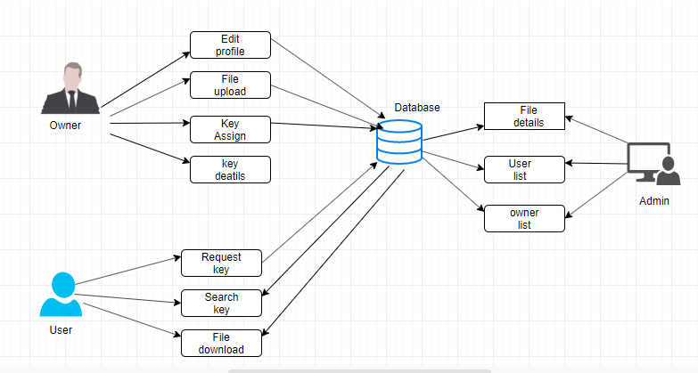
ARCHITECTURAL DESIGN:

Slide 8
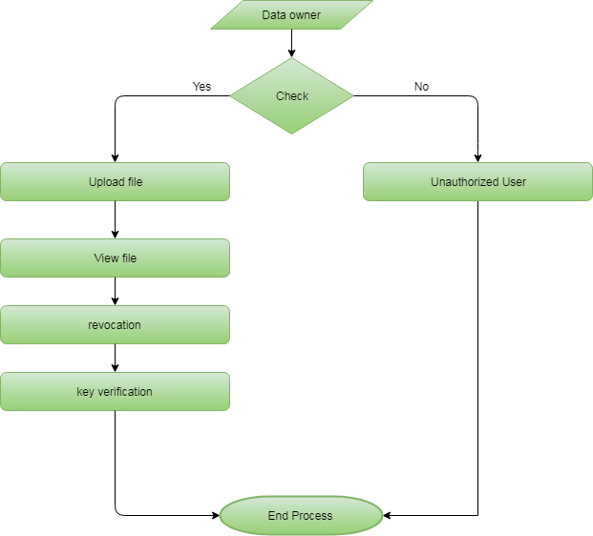

Slide 9
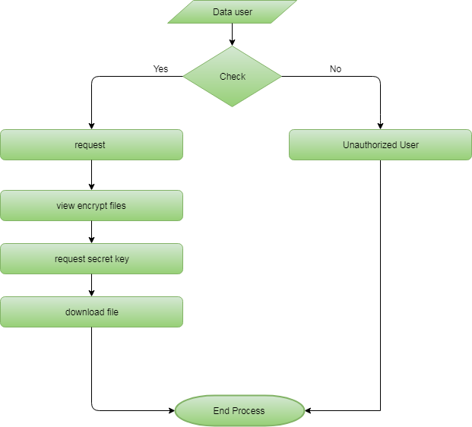

Slide 10


Slide 11


Slide 12
MODULES:
Authentication
Authorization
Checking Internet Connection
Admin
Register
File Upload
Secret Key
User Request key
File Search and download

Slide 13
1) Authentication:
Authentication technology provides access control for systems by checking to see if a user's credentials match the credentials in a database of authorized users or in a data authentication server.
Users are usually identified with a user ID, and authentication is accomplished when the user provides a credential, for example, a password, that matches that user ID
2) Authorization:
Authorization is the process of giving someone permission to do or have something.
In multi-user computer systems, a system administrator defines for the system which users are allowed access to the system and what privileges of use (such as access to which file directories, hours of access, amount of allocated storage space, and so forth).

Slide 14
3) Checking Internet Connection :
First, check that mobile data is turned on and you have a data connection. Open your Settings app "Wireless and Networks" or "Connections" Mobile data or Cellular data.
4) Register:
Users have to register them to get their scrap metals. This page contains six fields such as Username, Password, Full name, Address, Email ID and Mobile number.
This module mainly implemented to the block chain validation
User details insert to the multiple tables and then each and every detail stored to the md5 has value format .this validation safe and secure to the users.
5) Admin:
In this module is maintaining a full application run in to this process. In this Process login to the application and then enter into the application. Then they are viewed in to the all process.

Slide 15
6) File Upload and file details:
After having access to all the operation in the application, the data owner now uploads files to the application, and during the upload, all the encryption methods are invoked, and the resulted encrypted data is then uploaded in the database.
7) Data security:
The application algorithm, after success full data consumer authentication, N-Authorities algorithm is then invoked to provide a public key, authority key for the owner and private key, authority key for the consumer to perform operations on files
8) Owner Secret key assign
The application algorithm, after success full data consumer authentication, N-Authorities algorithm is then invoked to provide a public key, authority key for the owner and private key, 88 authority key for the consumer to perform operations on files

Slide 16
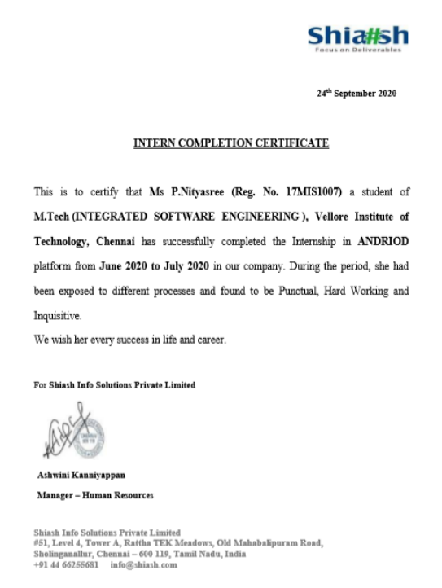
INTERNSHIP CERTIFICATION:

Slide 17
THANK YOU

